Slide 1
HTML5 Tags
Video
Audio
Canvas

Slide 2
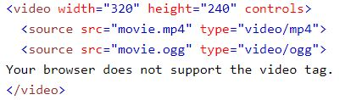
Video <video></video>
width sets the width in pixels
height sets the height in pixels
source specifies alternative videos for specific browsers
controls adds video controls
autoplay starts the video once loaded
Type specifies the media type

Slide 3
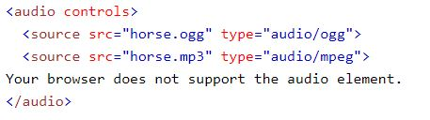
Audio <audio></audio>
source specifies alternative videos for specific browsers
controls adds video controls
type specifies the media type

Slide 4
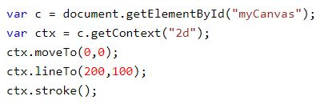
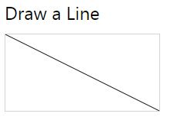
Canvas <canvas></ canvas >
uses JavaScript to draw images on page
HTML
JavaScript
Results

